Slide 1

Banking Data for Marketing Targets
- Abhishek, Amit, Priyal, Rishu

Slide 2
INTRODUCTION
Objective of Analysis: Analyze client data to target term deposit prospects, and to plan effective marketing strategies.
Data Overview: Analyze a dataset of 45,211 clients, Key variables: Age, Job, Marital Status, Education, Default Status, Balance, Housing Loan, Contact Details (Day, Month, Duration), Campaign Data, Previous Contacts, Previous Outcome, and Response (y)
Hypothesis Formulation: We have analyzed 3 hypothesis to support our suggestions.
Expected Outcomes: Identify key factors influencing the decision to invest in term deposits, Generate insights for targeted marketing strategies, enhancing the efficiency of client outreach.
Action Plan: Based on the analysis, prioritize clients based on their likelihood to invest in term deposits, Create tailored marketing campaigns to engage the identified target clients effectively.

Slide 3
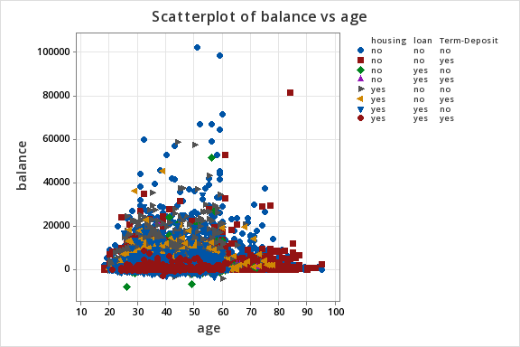
TYPICAL CLIENT AT A BANK
Total Client – 45, 211
Age - average client is 40.94 years old
Balance: The average balance is 1362.27 euros, but there is a significant standard deviation indicating a wide range of balances. Some clients have negative balances.
Duration: The average last contact duration is 258.16 seconds, with a standard deviation of 257.53, suggesting a wide range of contact lengths.
Campaign: The average number of contacts per client is 2.76, with a maximum of 63 contacts.
pdays: Most clients have not been contacted in previous campaigns (-1), as indicated by the high frequency of -1 values.
previous: Most clients have not had previous contacts (0), aligning with the pdays data.

Slide 4
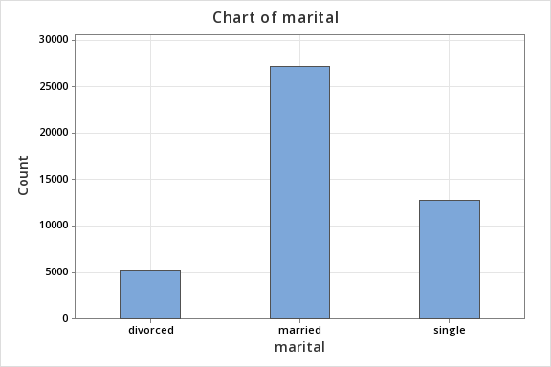
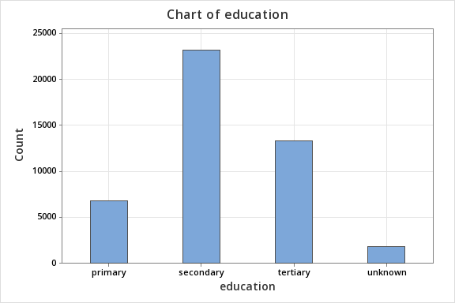
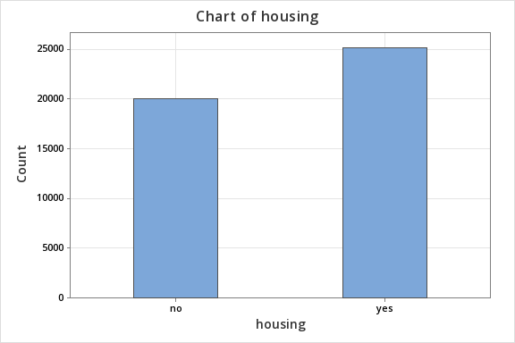
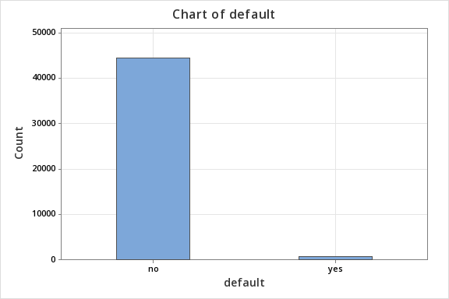

Slide 5
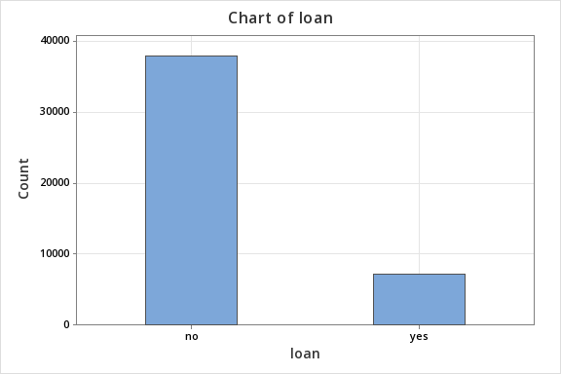
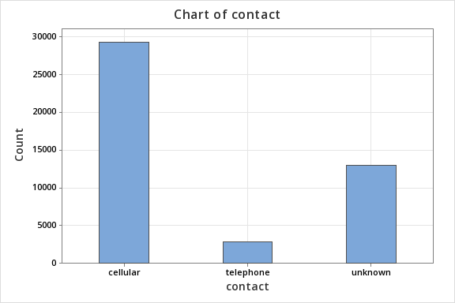
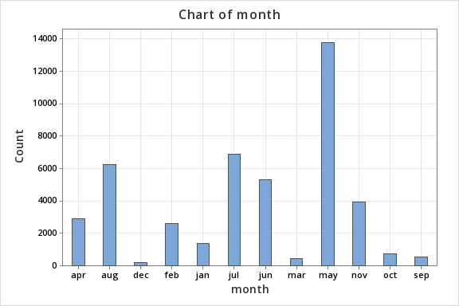
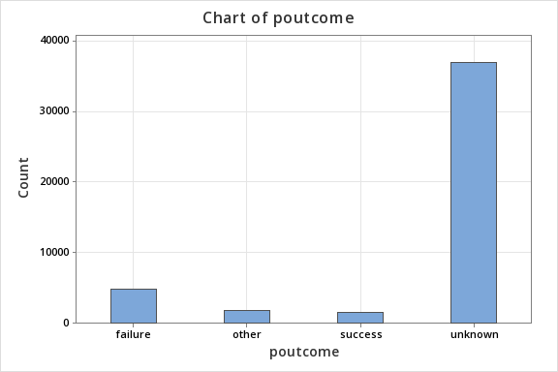

Slide 6
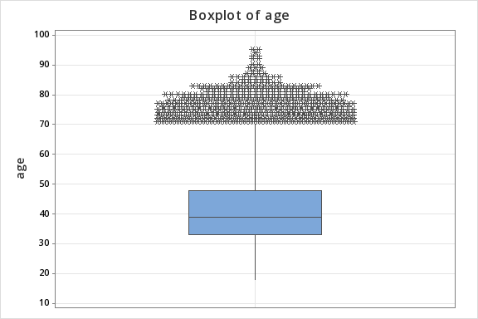
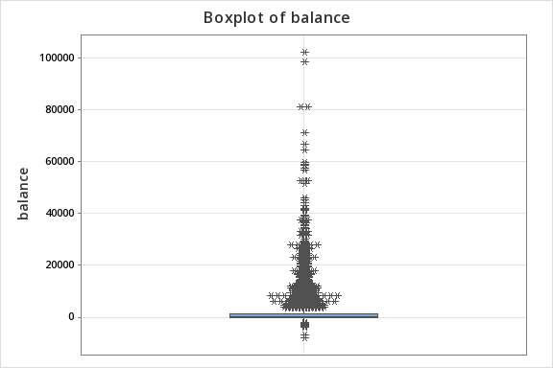
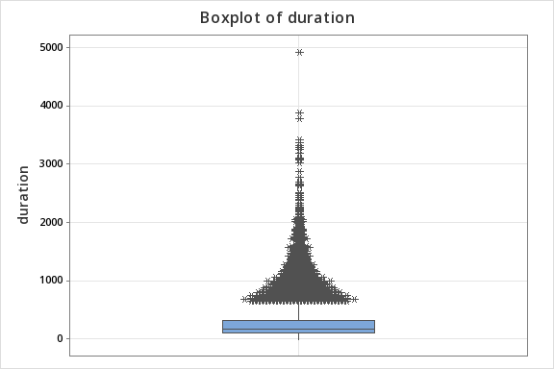
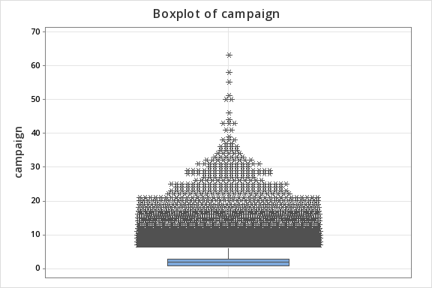

Slide 7
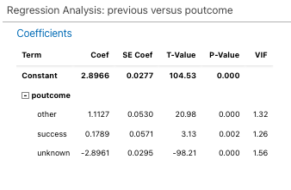
HYPOTHESIS 1
Hypothesis 1: Higher number of communications in previous campaigns lead to more successful outcomes
Key Findings:
Cross-Tabulation: The table provides the frequency of each combination of "poutcome" and "previous" values.
Chi-Square Test:
Pearson Chi-Square: 46465.534
Degrees of Freedom (DF): 120
P-Value: 0.000 (assuming based on the extremely large chi-square statistic)
Likelihood Ratio: 43119.389 (similar to the Pearson chi-square)
Expected Counts: There are 14 cells with expected counts less than 5, which might indicate that the chi-square approximation might not be perfectly accurate.
Cramer's V: 0.342563 (a measure of association strength, indicating a moderate association).
Interpretation:
P-Value: The p-value of 0.000 is significantly less than any reasonable alpha level (e.g., 0.05, 0.01). This indicates that the observed association between "poutcome" and "previous" is highly unlikely to occur by chance if there were no true relationship between the variables.
Conclusion:
Based on the chi-square test and the p-value:
There is a strong association between "poutcome" and "previous".
The observed relationship is statistically significant and is unlikely to be due to chance.
The number of previous contacts significantly influences the outcome of the marketing campaign.

Slide 8
HYPOTHESIS 2
Hypothesis 2: Customers with Higher Balances are More Likely to Subscribe
Analysing the Relationship Between Balance and Term Deposits
Understanding the Data:
The provided cross-tabulation shows the relationship between "Term-Deposit" and "Balance Reformatted" (presumably categorized into "high" and "low").
Key Findings:
High Balance: 16.32% of customers with high balances subscribed to term deposits.
Low Balance: 10.23% of customers with low balances subscribed to term deposits.
Conclusion:
Customers with higher balances are more likely to subscribe to term deposits.
The percentage of subscribers is significantly higher among customers with high balances (16.32%) compared to those with low balances (10.23%). This suggests a positive association between higher balances and the likelihood of subscribing to term deposits.
Term Deposit | High Balance | Low Balance | Total
Yes | 1778 | 3511 | 5289
No | 9117 | 30805 | 39922
Total | 10895 | 34316 | 45211
% of high balance with term-deposit | 16.32%
% of low balance with term-deposit | 10.23%

Slide 9
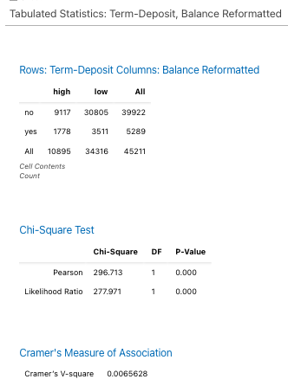
Interpreting the Cross-Tabulation and Chi-Square Test
Understanding the Output:
The provided output shows a cross-tabulation of "Term-Deposit" (rows) and "Balance Reformatted" (columns), along with a chi-square test to assess the association between these two variables.
Key Findings:
Cross-Tabulation: The table provides the frequency of each combination of "Term-Deposit" and "Balance Reformatted" values. For example, there are 9117 cases where "Term-Deposit" is "no" and "Balance Reformatted" is "high".
Chi-Square Test:
Pearson Chi-Square: 296.713
Degrees of Freedom (DF): 1
P-Value: 0.000
Likelihood Ratio: 277.971 (similar to the Pearson chi-square)
Cramer's V-square: 0.0065628
Interpretation:
P-Value: The p-value of 0.000 is significantly less than any reasonable alpha level (e.g., 0.05, 0.01). This indicates that the observed association between "Term-Deposit" and "Balance Reformatted" is highly unlikely to occur by chance if there were no true relationship between the variables.
Conclusion:
Based on the chi-square test and the p-value:
There is a strong association between "Term-Deposit" and "Balance Reformatted".
The observed relationship is statistically significant and is unlikely to be due to chance.
The balance (high or low) significantly influences whether a customer subscribes to a term deposit.

Slide 10
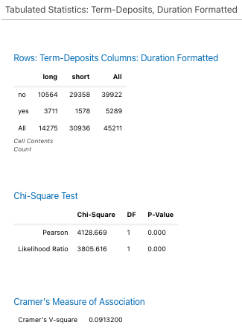
HYPOTHESIS 3
Hypothesis 3 : Longer Call Durations Lead to Higher Subscription Rates
Analysing the Cross-Tabulation and Chi-Square Test
Understanding the Output:
The provided output shows a cross-tabulation of "Term-Deposits" (rows) and "Duration Formatted" (columns), along with a chi-square test to assess the association between these two variables.
Key Findings:
Cross-Tabulation: The table provides the frequency of each combination of "Term-Deposits" and "Duration Formatted" values. For example, there are 10564 cases where "Term-Deposits" is "no" and "Duration Formatted" is "long".
Chi-Square Test:
Pearson Chi-Square: 4128.669
Degrees of Freedom (DF): 1
P-Value: 0.000
Likelihood Ratio: 3805.616 (similar to the Pearson chi-square)
Cramer's V-square: 0.0913200
Interpretation:
P-Value: The p-value of 0.00. This indicates that the observed association between "Term-Deposits" and "Duration Formatted" is highly unlikely to occur by chance if there were no true relationship between the variables.
Conclusion:
Based on the chi-square test and the p-value:
There is a strong association between "Term-Deposits" and "Duration Formatted".
The observed relationship is statistically significant and is unlikely to be due to chance.
The duration of the call (long or short) significantly influences whether a customer subscribes to a term deposit.

Slide 11
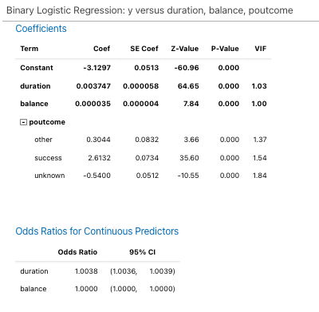
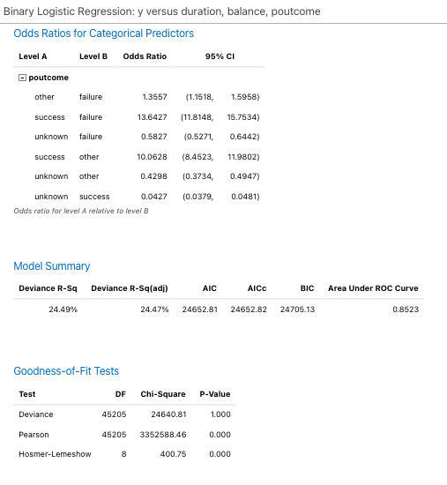
BINARY LOGISTIC REGRESSION
Interpreting the Binary Logistic Regression Model (duration, balance, poutcome)
Understanding the Output:
The provided output presents a binary logistic regression model predicting the likelihood of a term deposit subscription ("y") based on the variables "duration", "balance", and "poutcome".
Key Components:
Regression Equation:
The equation provides the predicted probability of "yes" (subscription) based on the values of "duration", "balance", and "poutcome".
The coefficients represent the impact of each predictor on the log odds of subscription.
Interpretation:
"duration":
The coefficient for "duration" is positive (0.003747), suggesting that an increase in the duration of the call is associated with a slight increase in the odds of subscription.
The odds ratio of 1.0038 (calculated from exp(0.003747)) indicates that a one-unit increase in "duration" is associated with a 0.38% increase in the odds of subscription.
"balance":
The coefficient for "balance" is also positive (0.000035), suggesting that an increase in the balance is associated with a very slight increase in the odds of subscription.
The odds ratio of 1.0000 (calculated from exp(0.000035)) indicates that a one-unit increase in "balance" has a minimal effect on the odds of subscription.
"poutcome":
Presents the odds ratios for different levels of "poutcome" relative to a reference level. For example, an odds ratio of 13.6427 for "success" compared to "failure" indicates that customers with a previous "success" are significantly more likely to subscribe to a termdeposit than those with a previous "failure".
The odds ratios suggest that customers with a previous "success" are significantly more likely to subscribe to a term deposit compared to those with "failure" or "unknown" outcomes.
Customers with a previous "failure" are also more likely to subscribe than those with an "unknown" outcome.

Slide 12
Model Summary:
The model explains 24.49% of the variance in the outcome (Deviance R-Sq).
The adjusted R-squared is slightly lower (24.47%), indicating that the inclusion of additional predictors might not have significantly improved the model's fit.
The AUC-ROC of 0.8523 suggests that the model has reasonably good predictive power.
Overall Interpretation:
The model suggests that the previous campaign outcome ("poutcome") has a significant impact on the likelihood of term deposit subscription. Customers with previous "success" are particularly likely to subscribe, while those with previous "failure" are also more likely to subscribe compared to those with an "unknown" outcome.
The model's overall fit is moderate, as indicated by the R-squared values and information criteria. There might be room for improvement by exploring additional predictors or considering alternative modelling approaches.

Slide 13
BINARY LOGISTIC REGRESSION FOR ALL VARIABLES
Important Predictor Variables
Housing: he coefficient for housing yes, is relatively large in magnitude.
Duration: The coefficient for duration is significantly positive, indicating that longer contact durations are associated with a higher probability of subscribing to a term deposit.
Poutcome success: The coefficient for poutcome success is significantly positive, suggesting that clients who subscribed to a term deposit in previous campaigns are more likely to do so again.
month mar: The coefficient for month mar is significantly positive, indicating that contacts made in March might be more effective in securing term deposits.
month_sep: The coefficient for month sep is significantly positive, suggesting that contacts made in September might also be effective.
job student: The coefficient for job student is significantly positive, suggesting that students might be more likely to subscribe to term deposits.
Less Important Predictors
age: The coefficient for age is very small and not statistically significant, suggesting that age might not be a strong predictor in this model.
balance: Similarly, the coefficient for balance is very small and not statistically significant.
pdays: The coefficient for pdays is also very small and not statistically significant.

Slide 14
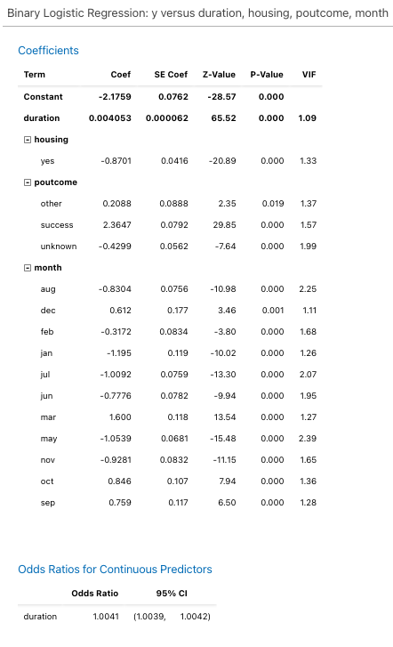
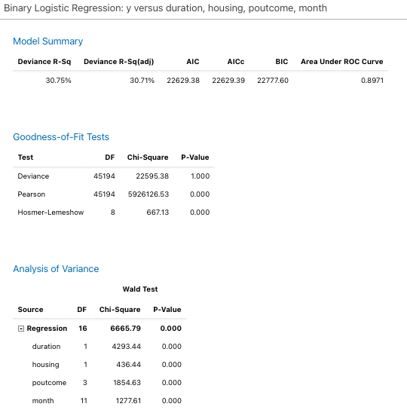
BINARY LOGISTIC REGRESSION: Term-Deposit vs Duration, housing, outcome & month

Slide 15
Model Summary
Deviance R-Sq: 30.75%
The model explains approximately 30.75% of the variation in the outcome variable (y).
AIC: 22629.38
A lower AIC value indicates a better-fitting model.
BIC: 22777.60
Similar to AIC, a lower BIC value suggests a better-fitting model.
Area Under ROC Curve: 0.8971
This indicates good predictive performance.
Goodness-of-Fit Tests
Deviance Test: p-value = 1.000
Suggests a good fit between the model and the data.
Pearson Test: p-value = 0.000
Indicates some discrepancies between observed and expected frequencies.
Hosmer-Lemeshow Test: p-value = 0.000
Suggests a lack of fit between the model and the data.
Analysis of Variance
Regression: p-value = 0.000
The overall model is statistically significant.
Individual Predictors:
duration, housing, poutcome, and month are all statistically significant predictors.
Interpreting Odds Ratios
duration: Longer duration is associated with higher odds of the outcome.
housing: Individuals with housing have lower odds of the outcome.
poutcome:
success is strongly associated with higher odds.
failure and unknown are associated with lower odds.
month: Certain months (e.g., mar, oct, sep) have higher odds associated with them.
Overall Interpretation
The model is statistically significant and has good predictive performance. However, there are some discrepancies between the observed and expected frequencies, as indicated by the Pearson test and Hosmer-Lemeshow test.

Slide 16
THANK YOU!

